Slide 1

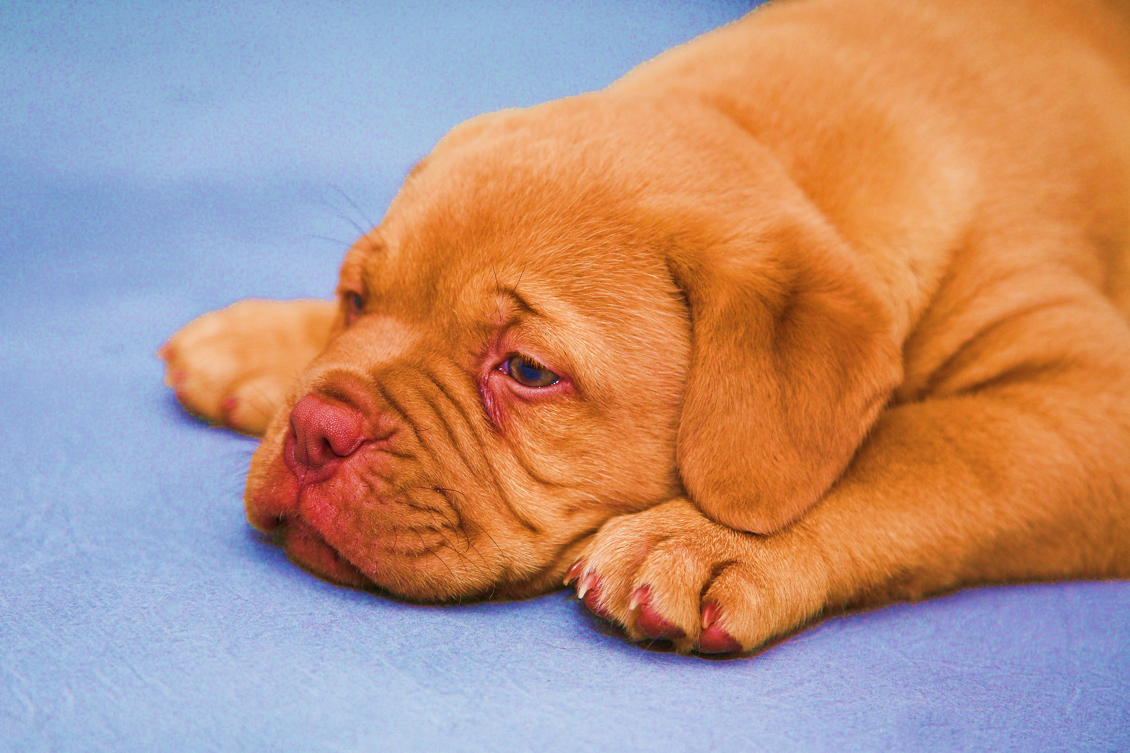
FURWAY
BY :
KHUSHI GUPTA : 2000300130066
KHUSHI JAIN : 2000300130067
LAKSHAY ANAND : 2000300130071
NAVYA : 2000300130084

Slide 2

PROBLEM STATEMENT
Many people know about dog vaccination these days but they don’t have the proper information regarding this topic.
Through our website we will help our users and provide all the necessary information about dog vaccination that what vaccine to give to their dogs at what age.

Slide 3
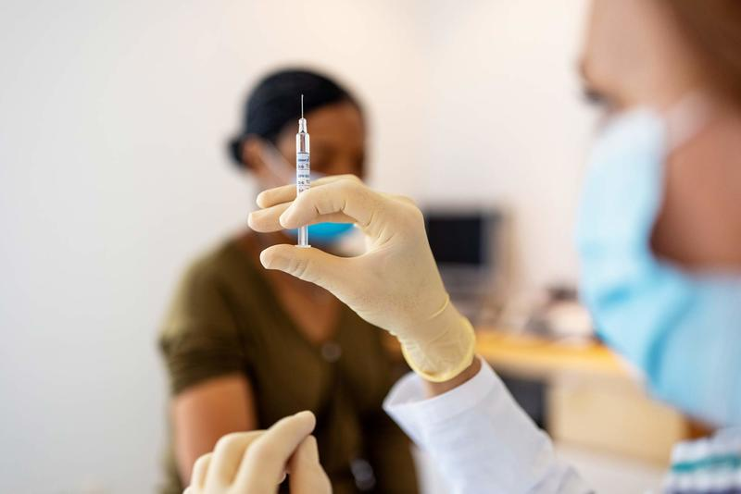
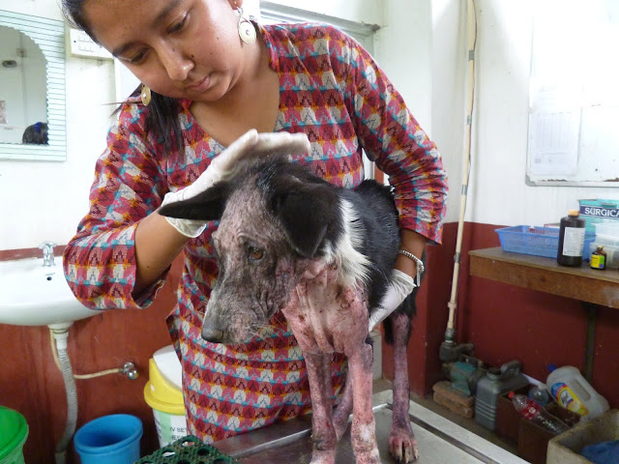
What is vaccination of dogs ?
Vaccination of dogs is the practice of animal vaccination applied to dogs. Programs in this field have contributed both to the health of dogs and to the public health.
In countries where routine rabies vaccination of dogs is practiced, for example , Rabies in humans is reduced to a very rare event.

Slide 4
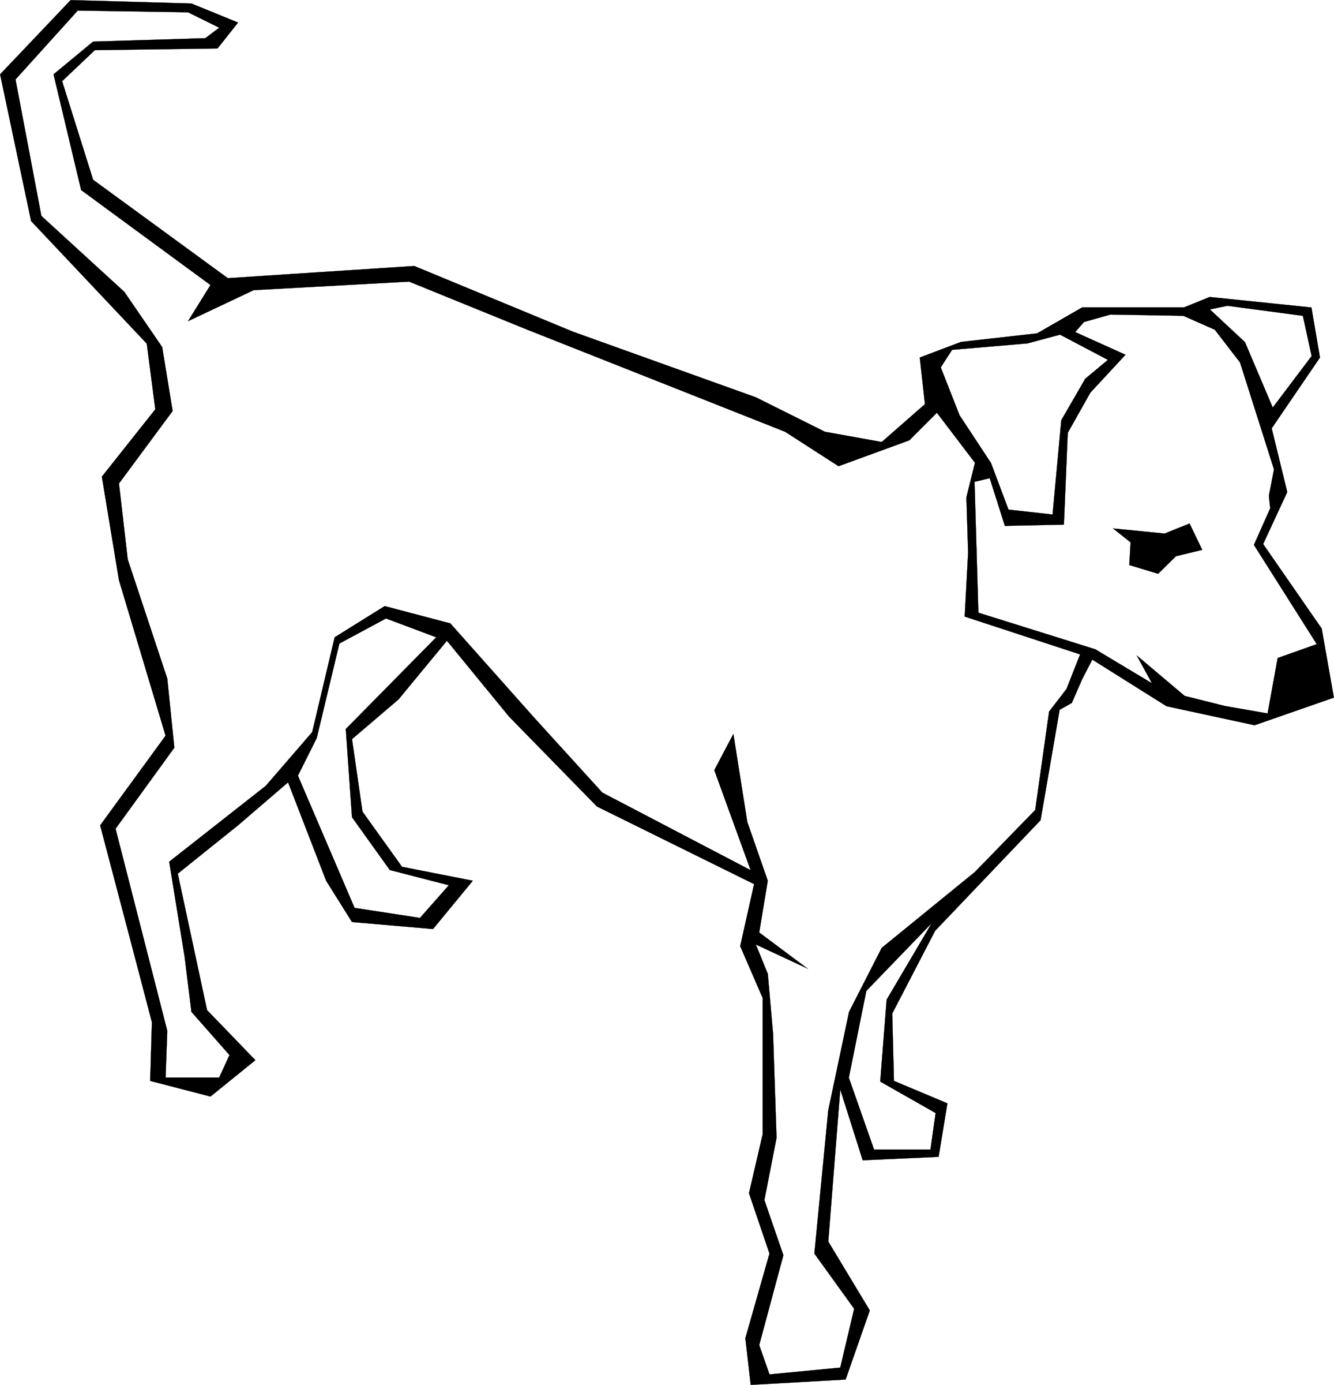
IMPORTANCE OF VACCINATION FOR DOGS
Vaccines help prepare a dog's immune system to defend itself from any invasion of disease-causing organisms.
Dog vaccinations play a critical role in protecting your dog from many dangerous and even fatal diseases.
Regular vaccines greatly increase your dog's protection against serious diseases

Slide 5





Technical specifications
1.Hypertext Markup Language
2.Cascade Style Sheets
3.Javascript
4.Google Chrome
5.Visual Studio Code

Slide 6

Work flow
Step 1
Go to home page.
Step 2
Login if already existing user otherwise sign up.
Step 3
Now users can check the vaccination and diet plan for dogs.
Step 4
Users can also check the adoption procedure for stray dogs and also can donate for them if they want to.

Slide 7
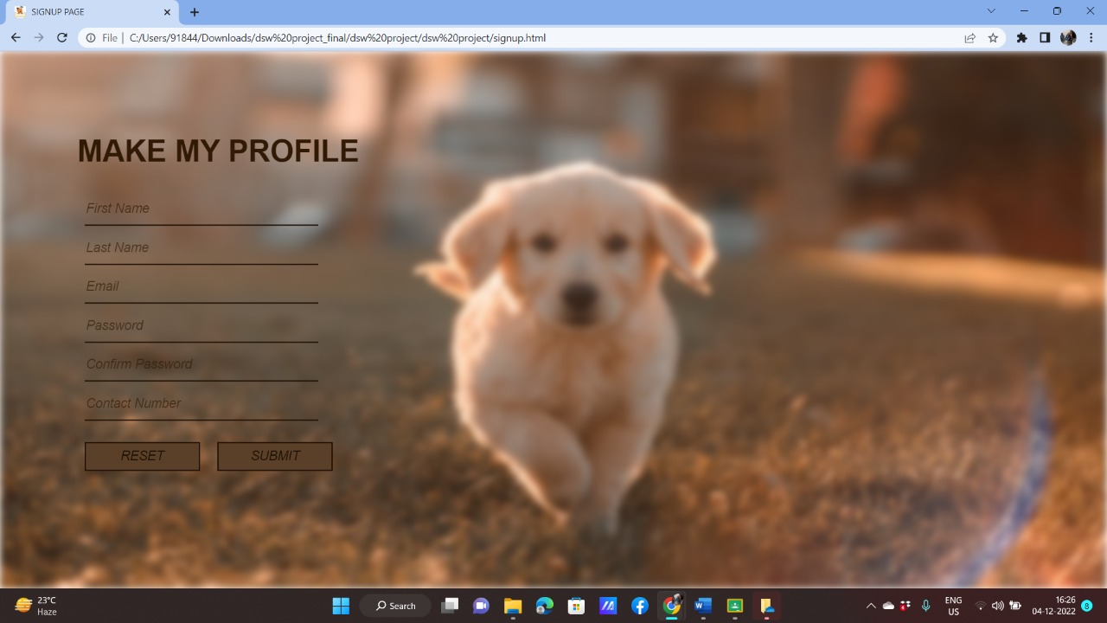
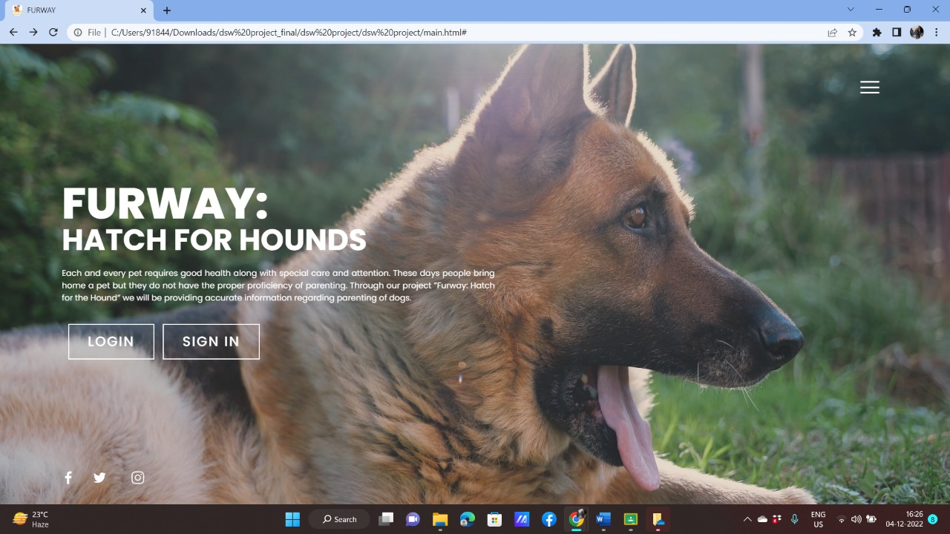
Web Site view

Slide 8
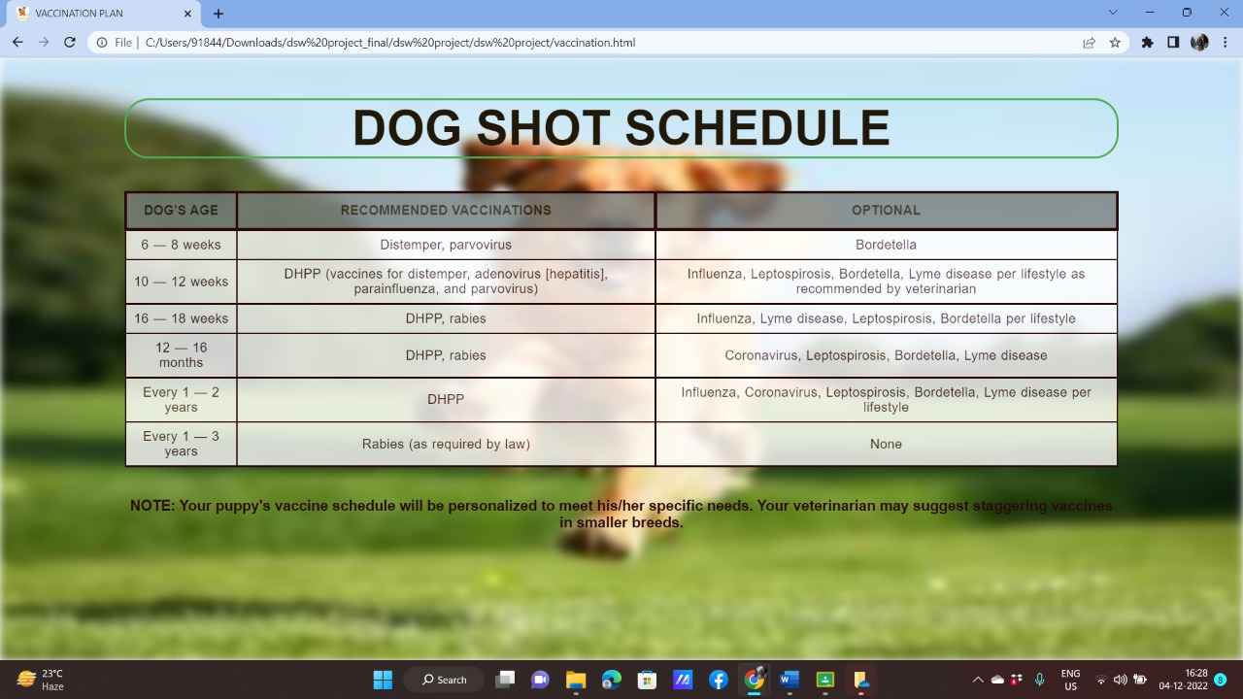
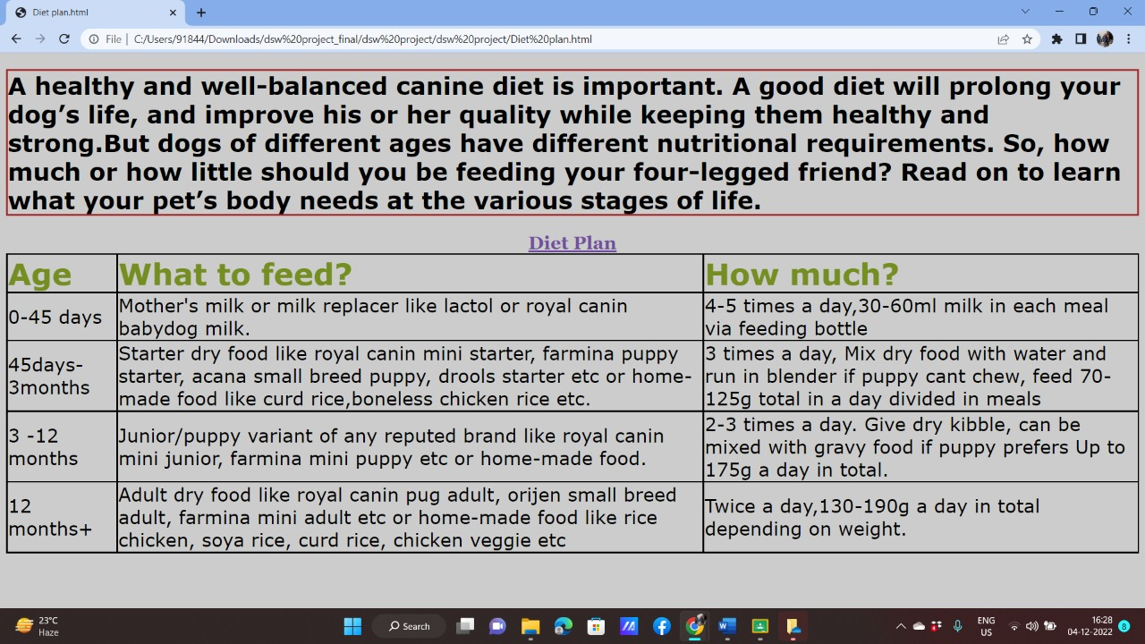

Slide 9
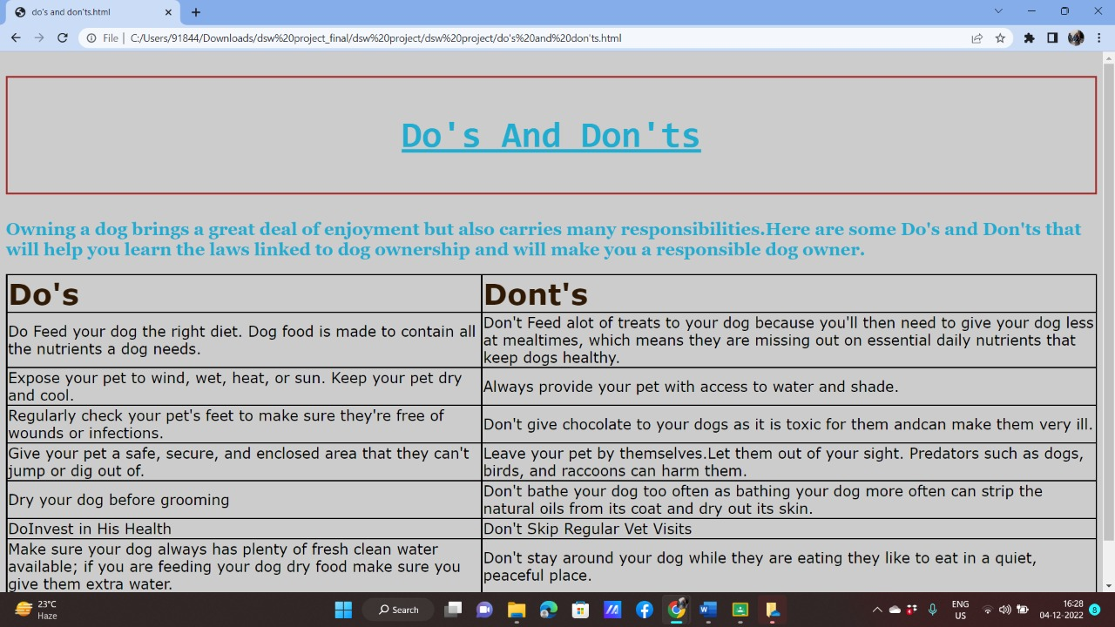
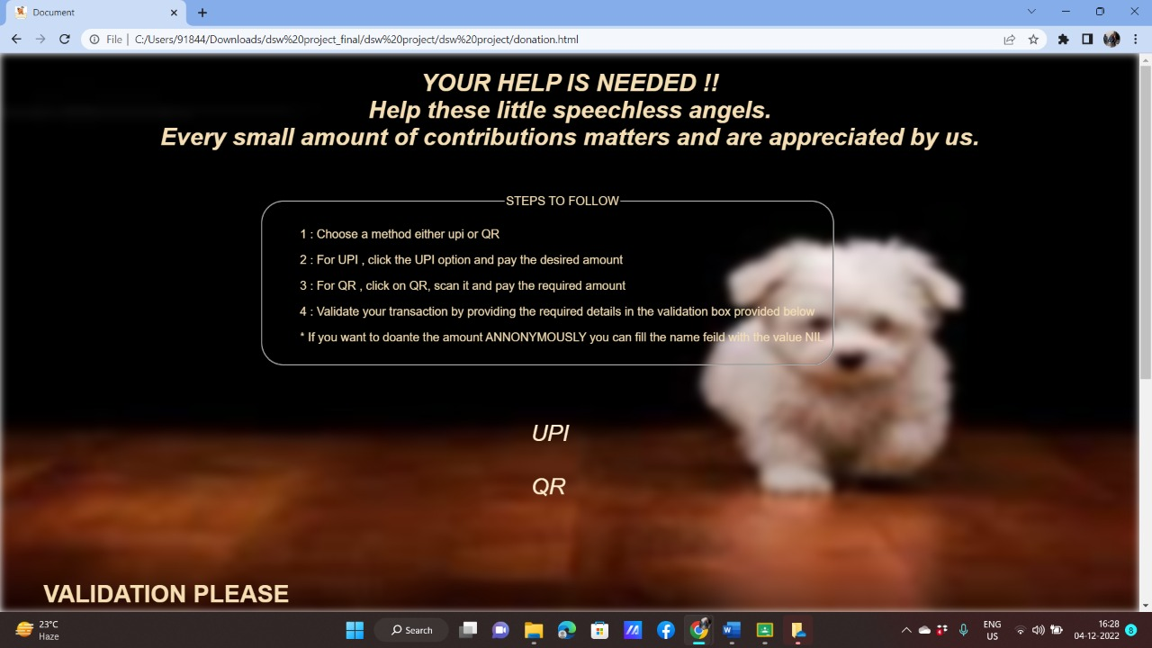

Slide 10
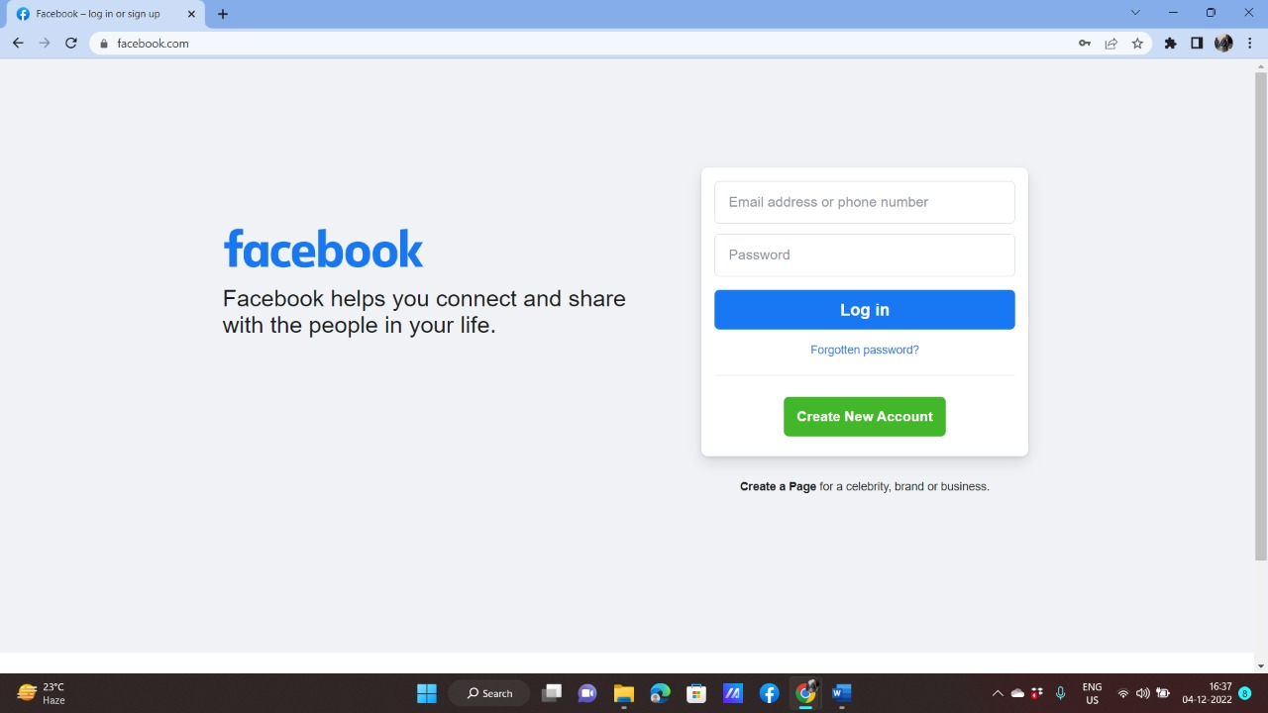

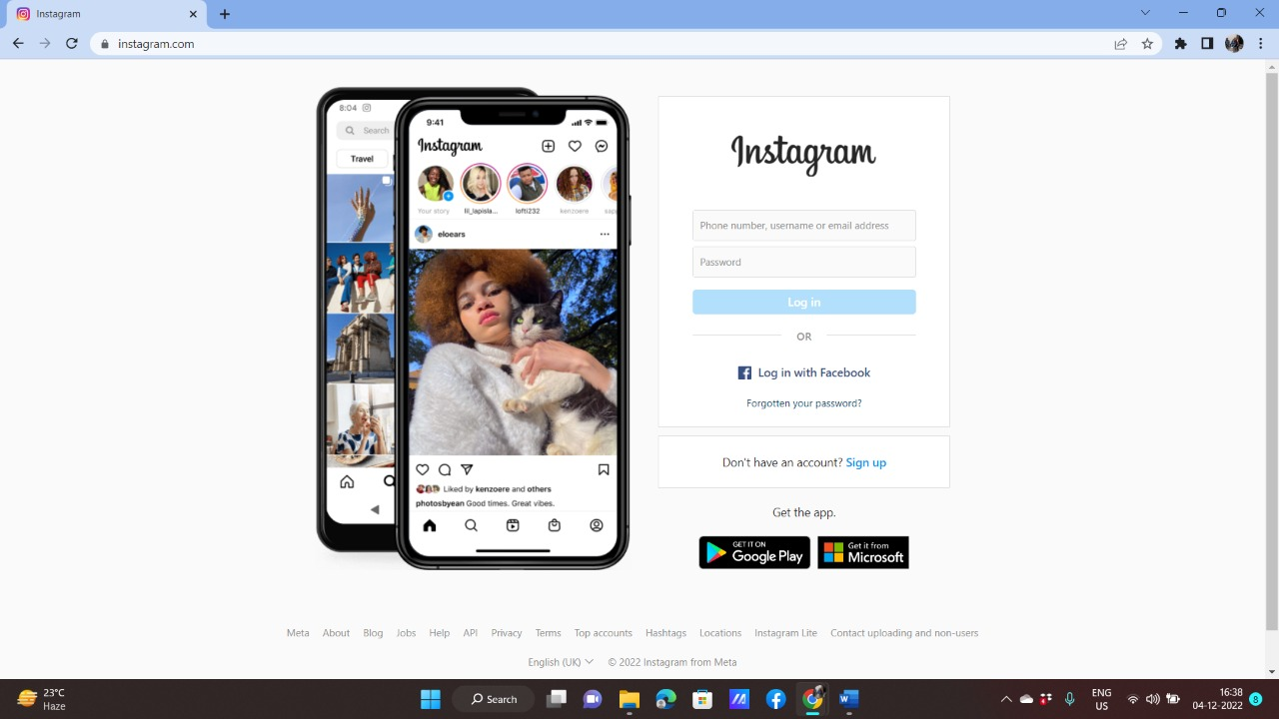

Slide 11
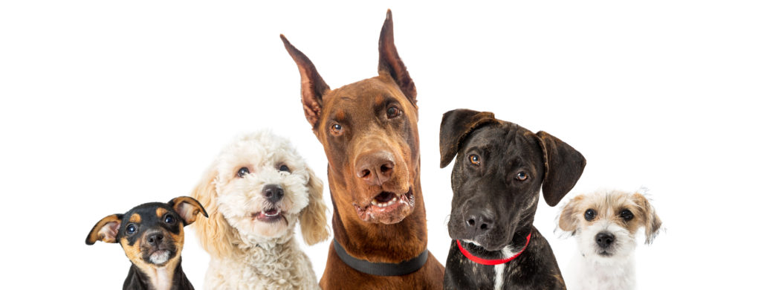
conclusion
Our website will help people to gather all the correct information about dog vaccination such as what vaccine to give at what age , what to do and what to not during their dog’s vaccination procedure.
Also our website will help users to adopt stray dogs and to donate for them if they want to through various social media platforms like Facebook , Instagram etc.

Slide 12


